Slide 1

Web Development with .NET Lecture 3: ASP.NET AJAX Part I, Cascading Style Sheets 8 February 2010
MET CS 651 - Chelmsford
“Making it all faster, prettier, & easier”

Slide 2
The problem with Postback
Each ASP.NET request results in a roundtrip a.k.a postback to the server
Each postback causes the requesting page to be refreshed, regardless of the nature or the sender of the request
With web users becoming more and more sophisticated, the request-response-refreshing (or click-n-wait) model becomes less and less desirable
In the case of heavy webpages, the lack of smooth performance simply drives users away
Website1

Slide 3
Remedy
ASP.NET built-in script callback mechanism: Various ways to work with JavaScript
The ClientScript class injects JavaScript into a webpage, to perform pure client-side tasks, such as window pop-ups, setting focus etc
This class uses a server-centric model, in which the server controls the operation
Another option is to use an object called XMLHttpRequest to bridge across server and client-side script, and to enable client-side script to make direct calls to the server
That is AJAX, and we’ll talk about this later
In this model, ASP.NET enables you to create both server-centric and client-centric models

Slide 4
ASP.NET JavaScript Callbacks
On the server side, the code-behind page class must use a method called GetCallbackEventReference
It must also implement the ICallbackEventHandler interface. The ICalbackEventHandler interface requires two methods:
RaiseCallbackEvent
GetCallbackResult
RaiseCallbackEvent () handles the necessary operation on the server
GetCallbackResult() returns the result to the calling script
Website1d

Slide 5
Drawbacks of Using Script Callbacks
Cross-browser Support
ASP.NET Script callbacks will work with Internet Explorer, Firefox and other Mozilla-compliant browsers. It ensures each compliant browser can call the server and return with server-side response, however not all browsers supports dynamic partial page updates
Even with those that do, it is important that script code strictly follows the W3C DOM (Document Object Model - DOM) standards
Server's Response Delivery Format
With each script's callback, the server responds with a string. This works very well with small amount of data. However, it gets problematic with large complex data types
Problem with multiple callbacks
ASP.NET script callback works fine with a single call generated from a single control. I gets messy if multiple controls issue multiple callbacks
To differentiate the calls and their senders, need to bundle all information into a string and pass that to GetCallbackEventReference(), which in turn will be passed to the RaiseCallbackEvent()
Also possible to write a custom class to handle multiple callbacks

Slide 6
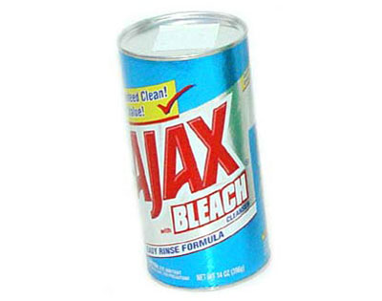
Asp.net AJAX
The Poor Rich Client

Slide 7
Almost Rich: The AJAX Breakthrough
Asynchronous JavaScript and XML
Term coined by Jesse James Garrett in 2005
Techniques date back to 1990
Not a technology per se, but a blanket term to indicate rich browser applications built using powerful combinations of client-side Web technologies that have been around for years
AJAX applications provide richer user experiences that are more similar to using desktop applications
Cascading Style Sheets (CSS) and X/DHTML for presentation, the DOM for data interaction and dynamic display, XML and XSLT for data interchange and manipulation, XMLHttpRequest for asynchronous communication

Slide 8
AJAX Prehistory
AJAX techniques for the asynchronous loading of content date back to the mid 1990s
Java applets introduced in the first version of the Java language in 1995. These allow compiled client-side code to load data asynchronously from the web server after a web page is loaded
In 1996, Internet Explorer introduced the IFrame element to HTML, to do the same thing
In 1999, Microsoft created the XMLHTTP ActiveX control in Internet Explorer 5, which evolved into XMLHttpRequest, now supported by all browsers
On April 5, 2006 the World Wide Web Consortium (W3C) released the first draft specification for XMLHttpRequest in an attempt to create an official web standard

Slide 9
AJAX How it works
Say you want to validate the content of a textbox against data stored on the server without forcing a full page refresh
You need to set up a parallel HTTP channel for sending the request and getting the response
The new request should be invisible to the user to avoid any interference with the displayed page
The response you get from this invisible request must be merged with the current page through dynamic changes to the document object model (DOM) of the page
XMLHttpRequest does all the work for you!

Slide 10
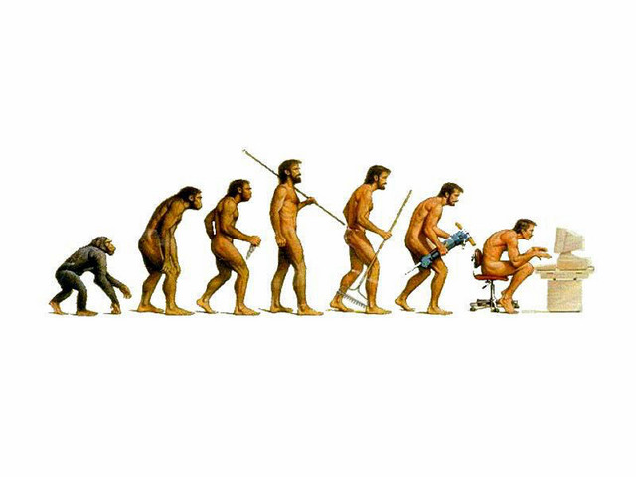
AJAX Evolution
Since 2005, there have been a number of developments in the technologies used in an AJAX application, and the definition of the term AJAX
JavaScript is not the only client-side scripting language that can be used for implementing an AJAX application. Other languages such as VBScript are also capable of the required functionality
XML is not required for data interchange and therefore XSLT is not required for the manipulation of data. JavaScript Object Notation (JSON) is often used as an alternative format for data interchange

Slide 11
IFrame
Typical Web site will refresh the entire page upon postback
Causes a lag for the clint, and much traffic for the server
Rich clients look at this and laugh!
First attempt at improving the Web app state of the art in this respect came with the introduction of IFrame in IE3 (1996)
Frame showing different content within page, independently refreshed
One master page, and subpages for each information pane
Ushered in the concept of a Web “portal”
IFrame, <div>, and <span> evolved into a grab-bag of technologies coined DHTML
DHTML: Pages that rewrite their own HTML

Slide 12

XMLHttpRequest
IE4: Microsoft Remote scripting (client/server TPC/IP socket communicating javascript)
IE5: XMLHttpRequest
Client-side ActiveX object
Soon implemented by all other commercial browsers
An example of industry copying Microsoft..
Down-level clients IE5 and IE6 expose XMLHttpRequest as ActiveX object
IE7 & up, Firefox, Safari, Opera support is at native Javascript object
XMLHttpRequest is asynchronous communications..
Improving the UI with AJAX
Website3 (Calculator)

Slide 13
So that’s the AJAX Plumbing
The raw infrastructure and logic of AJAX is simple
However, using AJAX in its raw form to write truly interactive and appealing web pages demands extensive skills in JavaScript and sidestepping the various traps caused by subtle differences between various browsers
Entails that programmers reinvent the wheel, repeatedly rewriting the same code to recreate the same behavior for common controls
Therefore, many AJAX frameworks have sprung up to free programmers from sweating with sending request and processing responses at its lowest level
Many frameworks also provide a set of sophisticated tools and protocols. ASP.NET AJAX (formerly known as ATLAS) is such a comprehensive framework

Slide 14


Coffee Break…

Slide 15
AJAX Extensions for ASP.NET
XMLHttpRequest is powerful, but complicated…
Server extensions
ScriptManager: Manages the scripts that will be downloaded to the client
UpdatePanel: Used to refresh the part of the page that is used in a partial page postback
UpdateProgress: Provides status info on the progress of the UpdatePanel download
Timer: Performs Postback at defined intervals. Can be used to trigger partial refreshes to UpdatePanels
Client extensions
Browser Compatibility Layer: abstracts away browser versions
Core Services: Javascript extensions for better event handling etc.
Base Class Library: Includes high-level-language components (e.g. error handling)
Networking: client/server communications

Slide 16
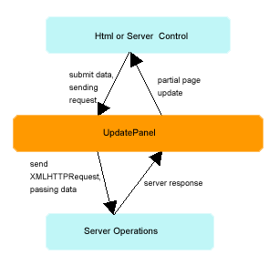
Server-centric AJAX
An ASP.NET AJAX application can be both server-centric or client centric
In a server-centric application, partial page updates are administrated by a server control called UpdatePanel
It behaves as a intermediate broker between the requesting and responding party, as shown in the following diagram

Slide 17
UpdatePanel
For a regular ASP.NET server page to realize partial page-update, the easiest way is to place one or more parts of web page inside an UpdatePanel
A web page can have multiple UpdatePanel controls
An UpdatePanel can also have nested UpdatePanel controls
It is also allowed to have controls outside of an UpdatePanel defined as triggers to fire a partial update
This is called partial rendering

Slide 18
ASP.NET AJAX Control Toolkit
While it is possible for the UpdatePanel control to work with client script, the functionalities are rather limited
Such as stopping and canceling asynchronous postbacks, custom error-message handling, etc.
And you must call a reference to the PageRequestManager class in the Microsoft AJAX library
It is more common to use the AJAX library to create custom client components to enable client behaviors, and then use these components as server controls' extensions
The host of components provided by the ASP.NET AJAX Control Toolkit is such custom client components.

Slide 19

Client-centric AJAX
In a client-centric AJAX application, a JavaScript function directly calls a Web Service through a script proxy class
A new set of rules must be strictly followed:
First for a Web service to be consumed by a client-side script, it must be marked with the ScriptService attribute
In the calling page, a reference to the Web service must be placed inside a ScriptManager control and specify its path to the Web service, as in the following code:

Slide 20
AJAX Extensions downloads
ASP.NET AJAX Core: Server and client controls
Control Toolkit: “Rich” client-side controls (e.g. calendar, tabbed pages, etc.)
ASP.NET AJAX Futures: CTP preview
AJAX Library: Client capabilities
Surf to http://www.asp.net/ajax/downloads/archive/
Download & install ASP.NET 2.0 AJAX Extensions 1.0
Download & install ASP.NET 2.0 AJAX Templates for VS2008 or VS2010
Optionally download and install AJAX Control Toolkit
(Toolkit demo)

Slide 21

AJAX Power Demos
Demo: ScriptManager and View Source
WebSite6
Demo: Faster implementation of Calculator with the AJAX UpdatePanel
<asp:ScriptManager>
<asp:UpdatePanel><ContentTemplate><asp:Panel>
Website7
Demo: Database manipulation
Making the most of client-side info
Website8 or Website8c

Slide 22

Web Mashup: Disintermediating the servers
A mashup is a web page or application that combines data or functionality from two or more external sources to create a new service
The term mashup implies easy, fast integration, frequently using open APIs and data sources to produce results that were not the original reason for producing the raw source data
An example of a mashup is the use of cartographic data to add location information to real estate data, thereby creating a new and distinct API that was not originally provided by either source (e.g. redfin)
Disintermediates the interim server

Slide 23
Scriptable Web Services & mashups
Creating a script-accessible Web Service is just like creating a regular, server-side accessible Web Service
Start by adding a Web Service to your Web Application Project
This will create a class with the WebService attribute
Uou can add methods to the Web Service by creating public methods marked with the WebMethod attribute
At this point we have a Web Service that can be called from .NET code
To make it accessible from client-side script, simply add the ScriptService attribute to the class
[ScriptService] attribute delivers pure Javascript on the client (with ASP.NET AJAX Js Libraries dependencies)
Only Web services with a [ScriptService] attribute can be called from client-side script
But so different…
In what ways?..

Slide 24
Scriptable Web Services & mashups
Traditionally, Web Services were called from compiled programs like from Windows Applications and the code-behind classes of ASP.NET web pages..
As web applications are continually pushing more functionality down to the client in the name of UI responsiveness, developers are needing to invoke Web Services directly from the client, without the cost of a roundtrip back to the server
The ASP.NET AJAX framework makes it easy to create script-accessible Web Services, and also offers integrated tools for invoking these Web Services directly through JavaScript
Rather than use SOAP, these Web Services use JSON, a popular message protocol for AJAX-enabled web applications

Slide 25
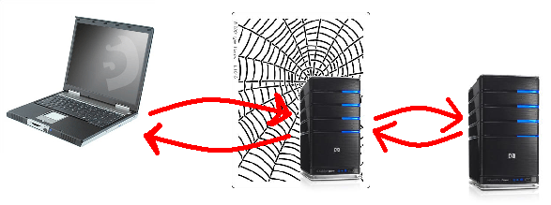
Non-Scripted
Client
Web Site
Web Service Server

Slide 26

Scripted
Client
Web Site
Web Service Server

Slide 27
ASP.NET AJAX Transports
Since AJAX services are exposed exclusively through HTTP, you can use virtually any text format to pack the body of requests and responses
JavaScript Object Notation (JSON) is the most commonly used format, but others, such as plain XML and raw text can also be used

Slide 28

JSON
JSON is a text-based format designed to move the state of an object across the tiers of an application. A JSON string can easily be evaluated to a JavaScript object through the familiar eval function. The JSON format describes the object, as shown here:
The string indicates an object with two properties, ID and Company, and their respective, text-serialized values. If a property is assigned a non-primitive value, say a custom object, the value is recursively serialized to JSON, like so:
Excerpts from MSDN Magazine

Slide 29
JSON advantage over XML
JSON is slightly simpler and more appropriate for use with the JavaScript language
While you can argue over which is easier to understand for humans, JSON is easier than XML for a Web browser to process
With JSON, you don't need anything like an XML parser. Everything you need in order to parse the text is built right into the JavaScript language
With JSON you gain a key architectural benefit at a relatively low cost:You reason in terms of objects everywhere.
On the server, you define your entities and implement them as classes in your favorite managed language
When a service method needs to return an instance of any class, the state of the object is serialized to JSON and travels over the wire
On the client, the JSON string is received and processed and its contents are loaded into an array or a kind of mirror JavaScript object with the same interface as the server class.
Excerpts from MSDN Magazine

Slide 30
Using XML
You could achieve the same result using XML, but then you would need an XML parser that can be used from JavaScript
Parsing some simple XML text in JavaScript may not be an issue, but using a full-blown parser is a different story
Performance and functionality-related issues will likely lead to the existence of numerous seemingly similar components that have little in common
And then there's the question of whether the JavaScript XML parser will support things like namespaces, schemas, white spaces, comments, processing instructions, and so on
Excerpts from MSDN Magazine

Slide 31
Security Concerns
AJAX allows for a more dynamic, interactive browsing experience
This, however, increases the surface area for common types of attacks such as cross-site scripting (XSS) and cross-site request forgery (CSRF)
These types of attacks are caused by an attacker injecting script code into a Web page, generally via a URL, thereby allowing the attacker to control the Web browser— performing actions such as stealing user names and passwords or executing HTTP requests without the user's knowledge
Because JSON is considered a safe subset of the JavaScript language (it excludes assignment and invocation operations), many AJAX applications simply pass JSON strings directly to the JavaScript eval function in order to create JavaScript objects. As a result, a malformed JSON string provides a new means for an attacker to execute unauthorized script on the client
Most of these attack types rely on exploiting the GET verb on an HTTP request. Fortunately, ASP.NET AJAX Services have the GET verb disabled by default on remote services
Excerpts from MSDN Magazine

Slide 32
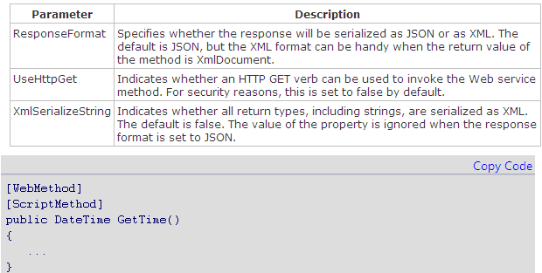
Default settings
By default, AJAX service methods are invoked only using the POST verb and return JSON formatted data
By using the optional ScriptMethod attribute on individual service methods, you can change these settings
Excerpts from MSDN Magazine

Slide 33
Client-side proxies
To invoke an AJAX service, an AJAX client follows the same pattern used to reference Web services in Windows and classic ASP.NET applications
A proxy class provides the same interface locally as the remote service & provides the basic capabilities for placing JSON calls
In ASP.NET AJAX applications, this proxy is a JavaScript class that the runtime generates when the page is downloaded.
The JavaScript proxy class has the same name as the script service and a number of additional properties.
If you want to take a look at its structure, try invoking the following URL from the browser's address bar:
The browser will download a JavaScript file that you can save to your local disk for later perusal

Slide 34
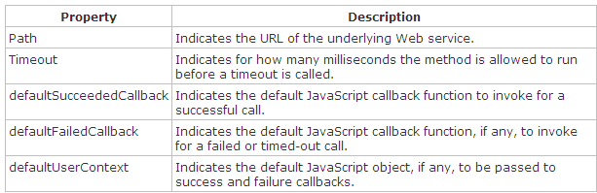
Client-side proxies
The JavaScript proxy class features the properties listed below
Each method mirrored has three parameters in addition to its regular set of arguments
They are the callback function to call if the method is successful, the callback function to call if the method fails or times out, and the context object to pass to both callbacks

Slide 35
Client-side proxies
Website9: Thin client web app that consumes a web service via Javascript-based proxies

Slide 36
Conclusion: ASP.NET AJAX architecture
Achieved by adding a few new server controls (ScriptManager and UpdatePanel), and having them silently perform a few tricks to transform a traditional postback asynchronously to the user experience, through the XMLHttpRequest object
An AJAX architecture (ASP.NET or not) is based on client and server being loosely coupled—essentially two separate worlds connected over the HTTP wire with JSON exchanging messages
Service-based back end and a JavaScript-powered front end
This decoupling should allow for emerging technologies, such as Silverlight, to continue enabling Web developers to create more interactive user interfaces without being constrained by the server platform
AJAX is all about the user's experience in the broadest sense—continuous feel, flicker-free updates, interface facilities, mashups, live data, etc.
Excerpts from MSDN Magazine

Slide 37


Discussion: Portal or mashup?

Slide 38


Cascading Style Sheets

Slide 39

Processing Credit Cards

Slide 40
Homework
Open a few CSS-enabled Web sites from the provided zip file
Pick your favorite, understand how it works and how to tailor it
Optional: Read “Credit Card…”, and “Integrating PayPal…”, and “Yahoo BOSS” papers
Source code: ASPNETECommerce.zip and paypalintegration.zip
Begin to browse Mashup textbook
Repeat Homework of last week, but have the sorted list of words instantly update as the text is entered by the user
Use your favorite CSS site to make your Web site graphically appealing
Repeat XMLHTTPRequest Lab, but with multiplication instead of addition
Download and install
ASP.NET 2.0 AJAX Extensions 1.0
ASP.NET 2.0 AJAX Templates for VS2008
AJAX Control Toolkit (optional)
Download and install Microsoft SQLServer Express (free), with Enterprise Manager option
Download latest AdventureWorks database (database only)
Launch Enterprise Manager and inspect database table and stored procedures
Try data-binding exercise on your own (SqlDataSource control)

Slide 41


